Slide 1
CSDS 451: Designing High Performant Systems for AI
Lecture 25
12/4/2025
Sanmukh Kuppannagari
sanmukh.kuppannagari@case.edu
https://sanmukh.research.st/
Case Western Reserve University

Slide 2
Outline
Note about where to go from here

Slide 3
Outline
Note about where to go from here

Slide 4
Trends in AI
The AI Index Report
An Yearly report on the trends in AI by Stanford University
A good resource to keep track of
https://aiindex.stanford.edu/report/

Slide 5






What did you learn in the course?
GPU Modeling
DRAM
$$0$$
$$1$$
$$S−1$$
C
C
C
0
1
$$p−1$$
0
1
$$p−1$$
0
1
$$p−1$$
$S$ Blocks
$p$ Threads per block

Slide 6
GPU Modeling
Have a mental model of how programs execute on GPUs
Data parallel programming – all cores execute same instructions on different data
Within SMP, data sharing and synchronization is relatively easy
Across SMP, sharing and synchronization is slower

Slide 7
GPU Modeling
Programming Languages
We studied HIP
Learn CUDA too
Very similar to HIP

Slide 8
GPU Modeling
Programming Languages
Most of Type #1 projects are targeted towards this. You also get to modify various layers of DNN models which again is an important skill
Explore as much as you can beyond what you proposed in the proposal. Keep on updating your github projects

Slide 9
Parallel Algorithm Design
Data parallelism is dominating the key computational kernel implementations
At the entire model level a combination of data and task parallelism is dominating
3D parallelism: data, model/pipeline, tensor parallelism

Slide 10
Parallel Algorithm Design
Understand key computational kernels and how to accelerate them
Convolution -> Matrix Multiplication: Blocked Matrix Multiplication
Sparse Matrix Multiplication -> several sophisticated techniques exist.
Prefix Scan/Sorting -> Usually recursive doubling based

Slide 11
Parallel Algorithm Design
At a model level, understand 3D parallelism
Play around with Pytorch-lightning, if possible, DeepSpeed
Type #2 projects have focused on this. Explore, put on your resume
(You should have HPC access for next several weeks, you can try it out and put it on your resumes)

Slide 12
AI/ML Models
We looked at:
Convolutional Neural Networks
Transformer Based Models
We could not look at:
Graph Neural Networks
Vision Transformers

Slide 13
AI/ML Models
CNN models, or at least the key kernel – Convolution will remain relevant moving forward
3D Convolution – 3D version of convolution
Increasingly being incorporated in Vision Transformers
Vision Transformers: convolution plus transformer layers
Critical to biomedical applications
Most popular model: U-net

Slide 14
AI/ML Models
Convolution Use Cases
One of my previous students needs to run heavy image segmentation models on CPU only client systems in real-time
Researchers in Biomedical engineering need to find out ways to run image processing extremely high resolution images

Slide 15
AI/ML Models
Transformer based Models
Go way beyond Natural Language Processing
Genomics, Protein sequences
Challenge here: How to model long context lengths (millions or billions)
Existing LLMs can handle around ~100,000 context length

Slide 16
AI/ML Models
Modeling Long Contexts
Specific sparsity patterns (e.g., ring attention) to achieve sequence parallelism
In general, the sparse attention mask have not been very successful
Reason: Existing implementations rely on Dense matrix multiplications
We discussed a few techniques in the course. Research on this topic is increasingly becoming relevant

Slide 17
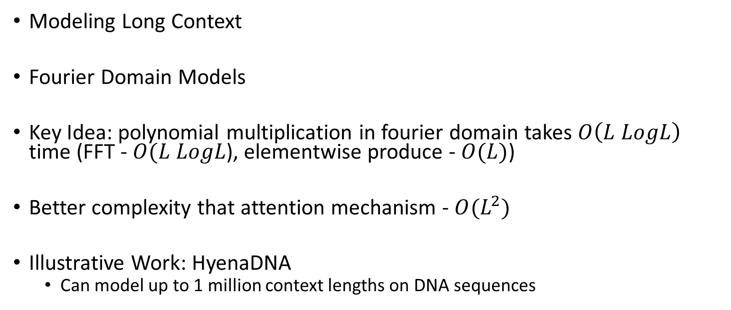
AI/ML Models
Modeling Long Context
Fourier Domain Models
Key Idea: polynomial multiplication in fourier domain takes $O\left(L LogL\right)$ time (FFT - $O(L LogL$), elementwise produce - $O(L)$)
Better complexity that attention mechanism - $O(L^{2})$
Illustrative Work: HyenaDNA
Can model up to 1 million context lengths on DNA sequences

Slide 18
AI/ML Models
Graph Neural Networks
Learning on Graph data
Important model in network analysis, molecular dynamic simulations, etc.

Slide 19
AI/ML Models
Some models to look out for
Neural Operators (Caltech) – Gaining popularity in tasks such as weather forecasting
Geometric Graph Neural Networks – Extensions of GNNs that are gaining popularity in scientific simulations
Liquid Time Constant Networks – Gaining popularity in robotics

Slide 20
AI/ML Models
Read their papers, go to their repos.
See if you can do some interesting self directed projects
See if you can accelerate them using some techniques that we learned in class
Untapped opportunity. No one has looked into accelerating these models yet.

Slide 21
Programming Skills
Pytorch is good for building models
But to really run them fast, you need C/C++
Its may be frustrating, not many people like it
That’s what makes it a coveted skill
Hardware Acceleration – CUDA/Sycl/OpenCL/HIP/ROCm
DNN Model Programming – Torch C++ Api
Look at the philosophy of when to use this: https://pytorch.org/cppdocs/frontend.html

Slide 22
Summary of Current Hot Skills in AI Systems
Thanks to Ketan Singh, Meta (Last year’s Career Talk Speaker)
Compilers, Distributed systems, ML courses
Learn graph manipulation frameworks like FX transforms in torch.compile, JAX
C++ services, Python based model authoring and boundaries in between.
Calling c++ libraries via python wrappers for performance and dev efficiency.
Distributed systems
Learn fundamental protocols of communication in a distributed setting.
Small companies: May need to build infra (using cloud services)
Large companies: Infra is built already, you need to use it properly
For model training/serving
Think about data transfers between hosts
Single host efficiency: CPU/GPU communication, pipelining instructions on GPU

Slide 23
Next Class
Life as an AI Engineer?

Slide 24
Thank You
Questions?
Email: sanmukh.kuppannagari@case.edu

